Slide 1

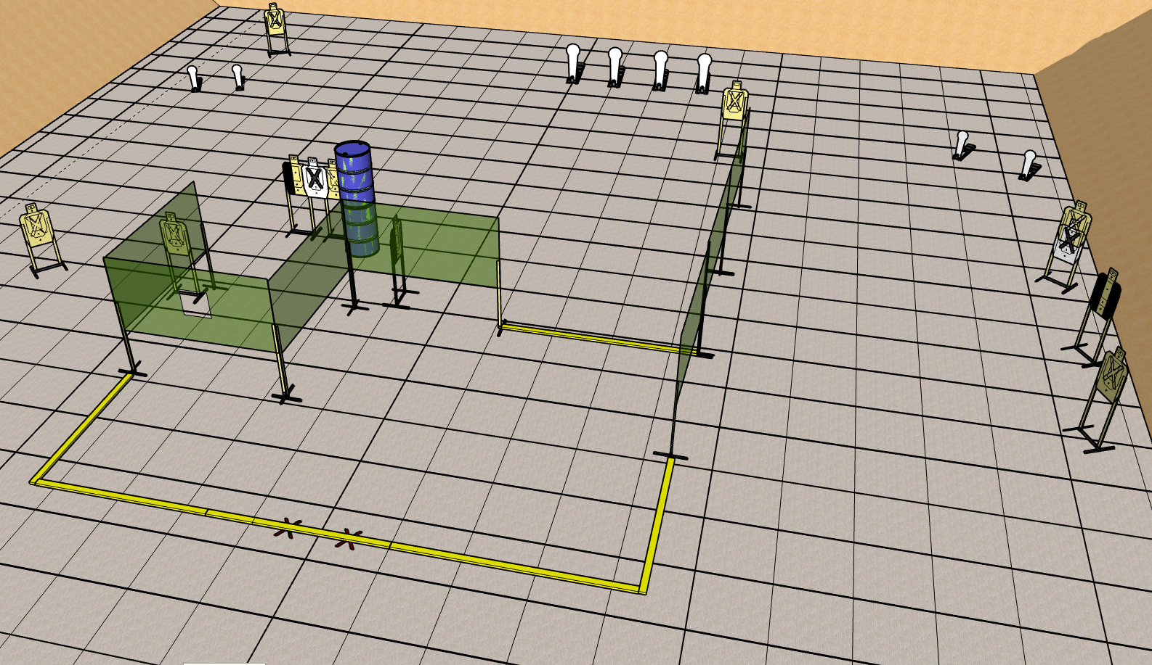
 | Renton Fish and Game Bay 3 You’re Entitled To Your Wrong Opinion Course Designer: Eric Beerbaum
Notes:
‹#›

Slide 2
Stage 3 You’re Entitled To Your Wrong Opinion Course Designer: Eric Beerbaum
You’re Entitled To Your Wrong Opinion is a 28 round, 140 point Comstock Medium course. There are 10 metric targets and 8 steel targets. The best two hits per target will score. Steel must fall to score. The start signal is audible
The Handgun start position is heels touching marks with wrists below belts. Handgun is loaded and holstered. The PCC start position is heels touching marks. PCC is loaded with stock touching belt.
On the audible start signal, engage all targets from within the shooting area.

